Slide 1
CMAC 3990.200
Systems Administration and Operations
Fall 2025 – Week 4.1 – September 16th, 2025
Directory Services and User Management Review
AWS Educate services

Slide 2

Objectives
Weekly Info
Obtaining a domain
VIP’s Review
  Multiple IP’s on a single interface
  Multiple interfaces
  Network interface bonding
LDAP Review
Samba Review
Clouds
  Instances
    Windows Instance Build Discussion
    Linux Instance Build Discussion
    Linux CLI Build Discussion
  Elastic Load Balancers
    Application Load Balancers Discussion
    Classic Load Balancers Discussion
    Build Examples Discussion

Slide 3

Weekly Info
“Evaluate your priorities and act upon them” – John C. Maxwell
  What is required?
  What gives the greatest return/reward?
  What can be delegated?
  What should be sacrificed?
Scientists discover dolphin speech patterns?!
Attendance
Good of the class
“It's all in how you arrange the thing... the careful balance of the
design is the motion.” – Andrew Wyeth

Slide 4
HW 5 & HW 6
50 Points Each
HW 5 – AWS Educate – Due September 26th
  Set up an account!
  Watch some short videos and complete some knowledge checks!
    Intro to AWS Management Console, Intro to Cloud 101
    https://jpatalon.cs.edinboro.edu/cmac3990/Assignment%206.pdf
HW 6 – Project Proposal – Due October 3rd
  Project Pickem – Tuesday September 23rd
    I will put the class roster into a randomizer and output a randomized list
    Students will select their project based on their position on the randomized list!
      Additionally select your partner and topic.
  Proposal will need…
    https://www.mavenlink.com/resources/project-proposal
    https://www.indeed.com/career-advice/career-development/how-to-write-a-project-proposal
    https://jpatalon.cs.edinboro.edu/cmac3990/Assignment%205.pdf
Project Picks
in one week!

Slide 5

Obtaining a Domain
GoDaddy, Squarespace, Hurricane Electric, etc…
  I used to use GoDaddy for years, but then Phil yelled at me
  I switched to Google Domains for all my domains
  Google sold their domain product to Squarespace
Quick demo of Squarespace Domains
  https://account.squarespace.com/domains
  Get a domain
  Search for a domain
  Add to cart
  Checkout!

Slide 6

AWS Educate
AWS Educate Account - https://aws.amazon.com/education/awseducate/
Videos, tutorials, and labs
We will walk through a few different methods of things!
  Make sure you can log in!
    You will need an AWS Educate account!
Key Items:
  Automation
  Version Control
  Repeatability
  Infrastructure as Code

Slide 7
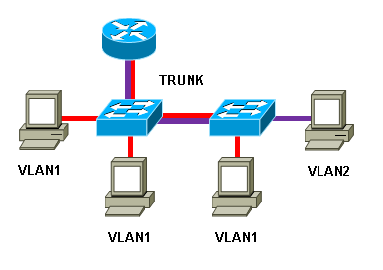
Virtual IP’s and Virtual LAN’s
Virtual Internet Protocol Address: VIP or VIPA
  An IP address that doesn't correspond to an actual physical network interface
  Useful for fault tolerance and mobility
  Considered to be a secondary IP, in addition to the server’s primary IP
Virtual Local Area Network: VLAN
  Uses VLAN Tagging Protocol – 802.1q
  Separates single physical networks into separate virtual networks
  Provides an additional layer of network security
    Subdivide a LAN into separate VLAN’s for separate traffic
  Trunking
    Multiple LAN’s on a single physical cable
  Requires supporting hardware!
    Switch, router, NIC, etc.

Slide 8
Network Bonding
The process of joining two or more network interfaces into a single interface
  Provides fault tolerance and redundancy
  Also called channel bonding, link aggregation, NIC teaming, and others
  Different types of bonding modes provide different features
    Round Robin – Default mode; packets are sent in order over each interface
    Active/Backup – One link is used, switched to secondary link in case of primary link failure
    XOR – Specific MAC address destinations are pinned to a specific interface
    Broadcast – All packets sent on all interfaces
    Link Aggregation – Interfaces are combined, increasing throughput
      Requires 802.3ad LACP switch support
    Transmit Load Balancing – Outgoing traffic is distributed depending on load
    Adaptive Load Balancing – Provides transmit and receive load balancing
    through ARP negotiation. Does not require specific switch configurations.

Slide 9
Network Bonding
The process of joining two or more network interfaces into a single interface
  Modes
  Link Monitoring
    Media independent interface monitor – MIIMON – Monitors the carrier state of the link
      Monitoring frequency – time between link state checks
      Link down delay – how long to wait before removing a link from the bond
      Link up delay – how long to wait before bringing a link back into the bond
    ARP Monitor – sends ARP queries to peers on the network to determine connectivity
      Monitoring frequency – time between ARP request transmissions
      ARP targets– a list of peer MAC addresses to query

Slide 10

Security-Enhanced Linux (SELinux)
SELinux is a kernel security module, that provides a mechanism for supporting access control policies
  Origins of SELinux can be traced to earlier projects by the NSA
  Provides a flexible mandatory access control (MAC) architecture into the major subsystems of the kernel
  Limits or reduces the ability of a compromised program to cause harm
  Independent of traditional Linux security access control mechanisms
  Capabilities of mandatory access controls, mandatory integrity controls, role-based access control (RBAC), and type enforcement architecture
    RBAC: Regulates access to a computer or network based on user roles
    Type enforcement: gives a subject access to objects based on rules in a security context
  Popular in container use
  Check status with getenforce command
    More detailed status information can be found with sestatus command
  Similar to AppArmor or Samsung Knox

Slide 11

Linux
Free and Open Source Software (FOSS)
  Free as in speech, not as in beer
  Source code readily available for anyone to view or modify
  Absolves programmers from liability
GNU Public License
  Dictates licensing behavior
  Software is free, may be modified and resold provided full source code
  and changes are released as open source
Kernel Differences
  Distribution vendors take a base kernel, add customized patching, perform additional QA
Upstream and Downstream
  Software project maintainers release tools and programs (upstream)
  Distribution vendors put software and tools together into a package (downstream)

Slide 12
Linux
Standards
  File Hierarchy Standard (FHS)
  Linux Standard Base (LSB)
Single, Multiple, Network User
  Windows originally a “one computer, one desk, one user” operating system
  Linux originally developed with networking and multiple users in mind
Registry and text files
  Windows uses a registry – a large database of configuration values
  Linux uses text files – small scattered configurations
Authentication
  Local and network

Slide 13

Linux Directory Structure
Root – Top level directory
  Represented by a forward slash /
  Similar to C:\ on Windows
/bin – User applications (binaries)
/sbin – System applications
/etc – Config files
/dev – Device files
  Virtual file systems!
/proc – Process Information
/var – Variable files
/usr – User programs
/opt – Additional optional programs
/home – Home directories
/root – Root user home directory
/boot – Boot loader files
/lib – System library files
/mnt – Mount directory
/tmp – Temporary files

Slide 14
Linux Commands
su – switch user command – allows user to impersonate another
  Most commonly used to impersonate root
sudo – switch user do (super user do) – run a command as another user
vi – visual editor – command driven text based editor
  Press i to switch to insert mode, esc to return to command mode
  Type command :wq! to save and close the file (write and quit)
  Most popular Unix/Linux editor
nano – simple text editor
  Caret symbol represents control button (^X = crtl+x)
gedit – graphical editor similar to Windows Notepad
joe – another simple editor

Slide 15
The Command Line
Directory structure navigation
  cd command lets us change directories
    cd /home/user/
  cd command by itself changes to users home directory
    cd
  Parent directory is represented by two periods
    cd ..
  pwd shows us what directory we are currently in
    [user@jason88 ~]$ pwd
    /home/user
  Files are edited with an editor
    vi, nano, joe, etc.
  Executables are executed
    /tmp/script.sh
The cd command (lowercase CD)

Slide 16
Linux Commands
mkdir – Make a directory
  Ex: mkdir /home/jpatalon/folder
useradd – add a new user
  Ex: useradd jpatalon
passwd – change a password
  Ex: passwd – Changes the password of the current user
  Ex: passwd jpatalon – Changes the password of user jpatalon
yum – Manage installed packages and software
  yum search <package>
  yum install <package>
  yum update
wget – download a file from the internet

Slide 17
Command Line Interface (CLI)
Background a job (&)
  Append an ampersand to the end of the command
    Ex: top &
  Bring the job into the foreground
    Ex: fg <job>
Environment Variables
  Various variables in your shell
    echo $SHELL
    var=asdf
    echo $var
  Variable can be numbers, words, letters, arrays, command output…
    var=$(cat /etc/fstab)
    var=`cat /etc/fstab`
      Backticks ^
Everything is case sensitive!

Slide 18
Command Line Interface (CLI)
Linux Shell
  Environment provided for a user; dictates commands and variable structures…
  BASH Shell – Bourne Again SHell
  C Shell
  KSH – Korn Shell
Tab completion (BASH)
  Type the first few letters, press tab, system will attempt to auto-complete
String multiple commands together
  Cat a file, grep for specific words, count the number of words
    Ex: cat /tmp/filename | grep words | wc
Man
  Run the man command to access manual pages!
    Ex: man which

Slide 19

Stream Editor (SED)
A text editor that edits information coming from input or files
Easily replace text within a file
Basic usage:
  sed [options] commands [file-to-edit]
Some simple examples:
  Replace all occurrences of the word “one” with the word “two” in a file
    sed -i ‘s/one/two/g’ file
  Delete a line that matches a pattern
    sed -i ‘/pattern/d’ file
  Can be combined with the pipe command to edit text inline

Slide 20
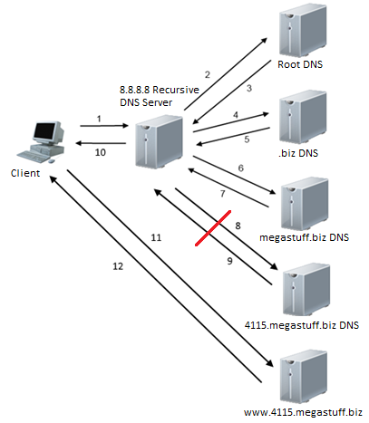
Why external DNS doesn’t work for our domains…
If we configure our servers to use Google’s free public
recursive DNS server 8.8.8.8, our query will fail!
Google’s 8.8.8.8 server cannot query our
41##.megastuff.biz name servers
  The EUP campus firewall prevents this!
The query cannot complete!
If we perform the same query against a
recursive DNS server in the CS subnet, the
query will succeed!
  We’ll just change our network configuration
  to make sure this will work!

Slide 21
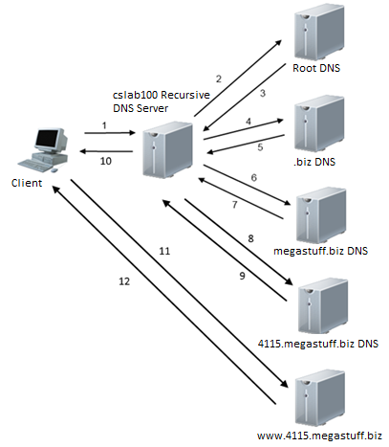
Why external DNS doesn’t work for our domains…
We will change our recursive DNS setting to use
the EUP CS servers cslab100.cs.edinboro.edu (147.64.242.100)
Since the cslab100/ server is on the cs network,
it is not being blocked from querying our servers
Recursive queries against our servers from cslab100
should still be blocked, but the authoritative DNS
resolution will work!
  We don’t want to provide recursive DNS services
  to the entire campus!
  Recursive queries from 147.64.243.96/27 will work
    147.64.243.96 – 147.64.243.127
    We configured this in our /etc/named.conf file!

Slide 22
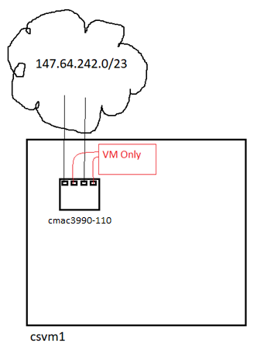
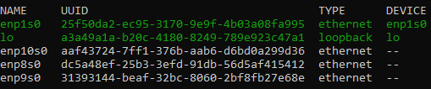
Our Network Config
Four Network Devices
  enp1s0 and enp8s0 are on the CS subnet 147.64.242.0/23
    We configured enp1s0 already
    We disabled enp8s0 as part of assignment 2
  enp9s0 and enp10s0 are on the private VM guest network
    enp9s0 and enp10s0 should be disabled from assignment 2

Slide 23
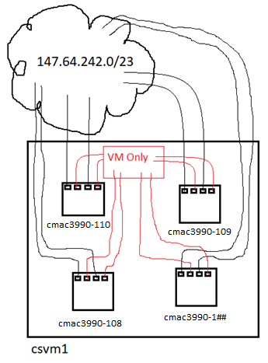
Our Network Config
Four Network Devices
  enp1s0 and enp8s0 are on the CS subnet 147.64.242.0/23
    We configured enp1s0 already
    We disabled enp8s0 as part of assignment 2
  enp9s0 and enp10s0 are on the private VM guest network
    enp9s0 and enp10s0 should be disabled from assignment 2
  Let us make some network changes!
    Create network bond master device bond0
      Reconfigure devices enp1s0 and enp8s0 to be slaves to bond0
    Clean up other network device files
      Make sure devices enp9s0 and enp10s0 are disabled
    We made these changes last week, detailed in last weeks slides!

Slide 24
CMAC 3990.200
Systems Administration and Operations
Fall 2025 – Week 4.2 – September 18th, 2025
Clouds & Weather

Slide 25
Objectives
Weekly Info
Assignment 3 review
Obtaining a domain
Clouds
  Instances
    Windows Instance Build
    Linux Instance Build
    Linux CLI Build
  Elastic Load Balancers
    Application Load Balancers
    Classic Load Balancers
    Build Examples

Slide 26
Weekly Info
“Evaluate your priorities and act upon them” – John C. Maxwell
  What is required?
  What gives the greatest return/reward?
  What can be delegated?
  What should be sacrificed?
Scientists discover dolphin speech patterns?!
Attendance
Good of the class
“It's all in how you arrange the thing... the careful balance of the
design is the motion.” – Andrew Wyeth

Slide 27
HW 5 & HW 6
50 Points Each
HW 5 – AWS Educate – Due September 26th
  Set up an account!
  Watch some short videos and complete some knowledge checks!
    Intro to AWS Management Console, Intro to Cloud 101
    https://jpatalon.cs.edinboro.edu/cmac3990/Assignment%206.pdf
HW 6 – Project Proposal – Due October 3rd
  Project Pickem – Tuesday September 23rd
    I will put the class roster into a randomizer and output a randomized list
    Students will select their project based on their position on the randomized list!
      Additionally select your partner and topic.
  Proposal will need…
    https://www.mavenlink.com/resources/project-proposal
    https://www.indeed.com/career-advice/career-development/how-to-write-a-project-proposal
    https://jpatalon.cs.edinboro.edu/cmac3990/Assignment%205.pdf
Project Picks
Next Class!

Slide 28
AWS Educate
AWS Educate Account - https://aws.amazon.com/education/awseducate/
Videos, tutorials, and labs
We will walk through a few different methods of things!
  Make sure you can log in!
    You will need an AWS Educate account!
Key Items:
  Automation
  Version Control
  Repeatability
  Infrastructure as Code
Assignment 5!
  https://jpatalon.cs.edinboro.edu/cmac3990/assignment5.pdf

Slide 29
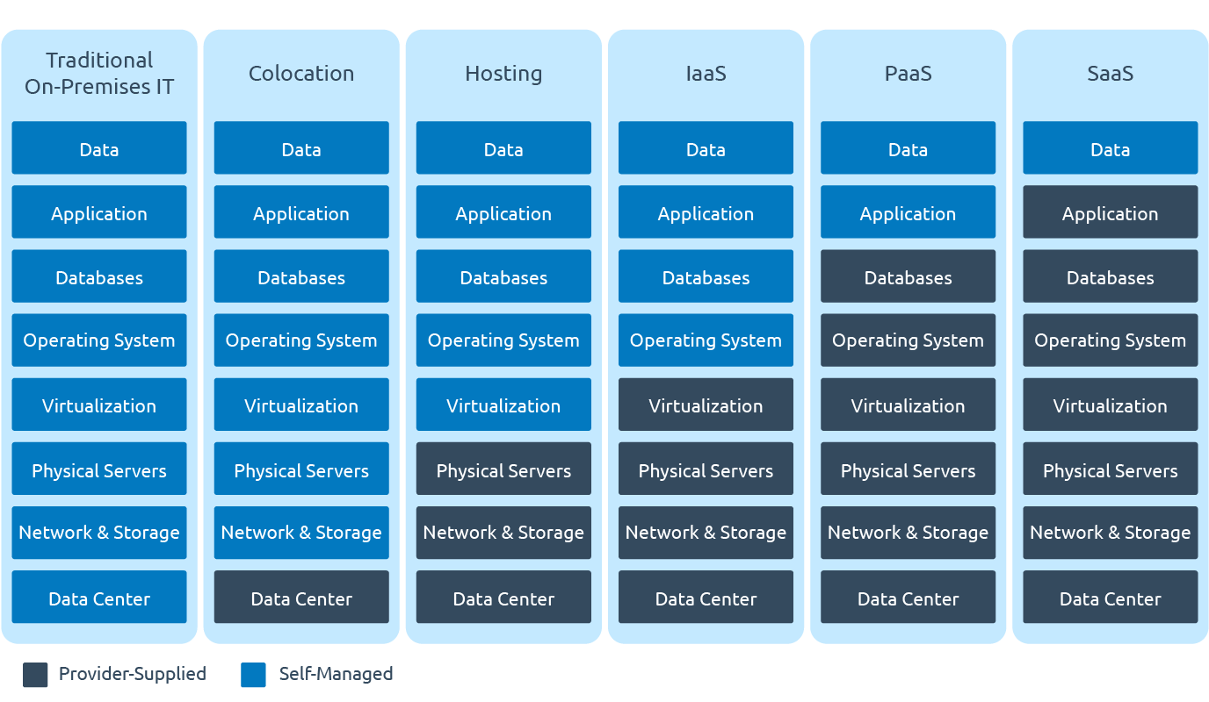
X as a Service (XaaS)

Slide 30

Amazon Web Services
EC2 – Elastic Compute Cloud – The Amazon Web Services component
Instance – Virtual Machine – A running VM, similar to our class VM’s
Amazon Machine Image (AMI) – Template – An OS installed and pre-configured to quickly deploy
Virtual Private Cloud (VPC) – Network – A virtual private non-routable network subnet
Internet Gateway (IGW) – Gateway/router – Next hop to the internet
Region – A generalized location where AWS physical services are located
Availability Zone – An individual data center within a region
Security Group – A virtual firewall
Elastic Load Balancer (ELB) – The Elastic Load Balancing Service from Amazon
will automatically distribute incoming application traffic across multiple
Amazon EC2 instances.
  Load balancers allow you to achieve fault tolerance in your applications,
  seamlessly providing the required amount of load balancing capacity
  needed to route application traffic.

Slide 31
Compute
Brains and processing power
CPU/RAM
Server in a data center
Full VM (or physical machine) dedicated to you
  Tons of different sizes and shapes
  Optimize for your workload
  Prices based on resources
Temporary code execution on a
non-dedicated machine
  Serverless Computing
EC2 – Elastic Compute Cloud
ECS – Elastic Container Service
ECR – Elastic Container Registry
EKS – Elastic Kubernetes Service
AWS Elastic Beanstalk
AWS Lambda
AWS Batch
AWS Lightsail

Slide 32
Elastic Compute Cloud (EC2)
EC2 – A virtual machine within your virtual AWS environment
  Amazon Machine Images (AMI’s)
    Template used to build a new server
    Create your own
    Marketplace, Community
  Instance Types
    Color, size, and shape of turtle (CPU/RAM/Network/Turbo/etc)
    Micro, General Purpose, Compute Optimized, GPU, FPGA, Memory, Storage
  Purchasing Options
    On-Demand
    Reserve 1+ years – Pay more up front for a better discount
    Scheduled – Reoccuring Schedule
    Spot – Unused resources – priced based on supply and demand
      Can be terminated with only a 2 minute warning.
    Reservations – Reserve capacity for a time

Slide 33
Elastic Compute Cloud (EC2)
EC2 – A virtual machine within your virtual AWS environment
  Tenancy – Where your VM actually runs
    Shared, Dedicated Instances, Dedicated Hosts
  User Data – Startup scripts
    Install tings automagically
  Storage
    Persistent Storage – EBS Volumes
      Separate from your instance, network connected, think “D:\” drive or a network NAS drive
      Attach/Detach, Encryption, snapshots, compression, replication…
    Ephemeral Storage – OS volumes
      Physically connected to the host, data lost when instance is terminated, cannot detach
  Security
    Security Group – A firewall for your EC2 Instance – Ports, protocols, sources, destinations…
    Key Pairs – Public/Private key used for authentication – AWS keeps public key, you keep private key
    It is your responsibility to maintain OS or application security and updates!

Slide 34
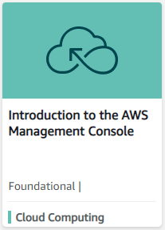
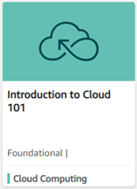
AWS Educate
AWS Educate Account - https://aws.amazon.com/education/awseducate/
  If you don’t have an account already, click the orange Register Now button
    Fill out the info using your Pennwest.edu email address, then make sure to verify your email!
    Your account will be validated/approved by AWS Educate Support; should be fairly quick!
  If you already have an AWS Educate account, Sign in to AWS Educate
Intro to the AWS Management Console
  Final Assessment Knowledge Check!
Intro to Cloud 101
  Final Assessment Knowledge Check!

Slide 35
AWS Educate
Free account
Introduction to AWS Management Console
Introduction to Cloud 101
  Module 1: Introduction to Cloud 101
  Module 2: Introduction to Cloud Computing
  Module 3: Introduction to AWS
  Module 4: AWS Core Services
  Module 5: Cloud Careers
  Module 6: Final Assessment
  https://jpatalon.cs.edinboro.edu/cmac3990/Assignment%205.pdf

Slide 36
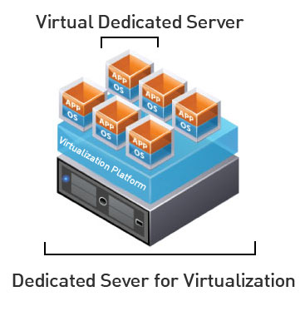
Virtual Machines
IP Address: 147.64.243.1## (01-25)
Hostname: cmac3990-1##.cs.edinboro.edu (01-25)
Alias: 41##.megastuff.biz (01-25)
Samba: \\147.64.243.1##\ (01-25)
Assignment 4 tasks – LDAP and Samba server install
  Uses commands discussed during class
  Due September 19th - run check script
    https://jpatalon.cs.edinboro.edu/cmac3990/classfiles/assignment4check.sh

Slide 37
Linux Commands
wget
echo
yum
nslookup
dig
vi
sed
smbpasswd
smbclient
systemctl
firewall-cmd
mount
chroot
setenforce
getenforce
sestatus
authconfig
getent

Slide 38

Key Terms and Items
Hubs
Switches
Routers
OSI Layers
Collision Detection
Print Servers
Multi Function Printers
Print Spooling
CUPS
Samba
Point and Print
Home Telephony
Internet of Things
OOB
LDAP

Slide 39

For Next Week
“Leadership means taking responsibility for prioritizing and thinking ahead.” – John C. Maxwell
Homework Assignment 4 – Due September 19th, 2025
Homework Assignment 5 – Due September 26th, 2025
Homework Assignment 6 – Due October 3rd, 2025
Textbook:
  Chapter 13: TCP/IP
  Chapter 14: Physical Networking
  Chapter 15: IP Routing
Next week topics
  Project pickem!
  Cloud, DHCP, NTP, Printing, more?

